Slide 1

BIG_MART.
MOHAMMED ADHEEB P
MES20MCA-2025
PRODUCT OWNER : PRIYA JD

Slide 2
TABLE OF CONTENTS
1.Introduction
2.Modules
3.Methodology
4.Project Plan
5.User Story
6.Product Backlog
7.Sprint Plan
8.Sprint Actual

Slide 3
INTRODUCTION
E-commerce or electronic commerce is a process of Buying, selling, transferring, or exchanging products, services, and/or information via electronic networks and computers. Commerce is a fundamental to the success of any business. To streamline trading operations and maintain profits, the industry must focus on commerce, which deals with a lot more than just buying and selling. As the world is digitalizing, ecommerce solutions are increasingly becoming common. The advent of machine learning and artificial intelligence has further enhanced the effectiveness of ecommerce. The examples of ecommerce include eBay, Amazon, Upwork, Olx, etc.
The advantages of ecommerce shopping are Lower price for products compared to traditional shopping, Time saving, we can avoid crowds in shopping, Available wide range and verity of products, shipping/delivery options and also it provides Feedback option from customers.

Slide 4
MODULES
Steps of this Project:
1. Business Understanding
Description
Objective
2. Data Understanding
Import Libraries
Load Data
Statistical summaries and visualizations
Mean, standard deviation
Heatmap, Distplot, Boxplot, Histplot, Scatterplot, Pairplot, Regplot
3. Data Preparation
Missing values imputation
Removing Irrelevant Column

Slide 5

4. Exploratory Data Analysis
Features Exploration:
Distplot, Boxplot, Histplot, Pairplot, Regplot, Barplot
5.Data Splitting: Train test split
6. Log Transformation:
The log transformation is, arguably, the most popular among the different types of transformations used to transform skewed data to approximately conform to normality. If the original data follows a log-normal distribution or approximately so, then the log-transformed data follows a normal or near
normal distribution.

Slide 6
7 Modeling:
Linear Regression ( model 1 )
A linear regression model describes the relationship between a dependent variable, y, and one or more independent variables, X. The dependent variable is also called the response variable. Independent variables are also called explanatory or predictor variables.
Lasso ( model 2 )
The goal of lasso regression is to obtain the subset of predictors that minimizes prediction error for a quantitative response variable. The lasso does this by imposing a constraint on the model parameters that causes regression coefficients for some variables to shrink toward zero.
Ridge ( model 3 )
Ridge regression is a model tuning method that is used to analyze any data that suffers from multicollinearity. This method performs L2 regularization. When the issue of multicollinearity occurs, least-squares are unbiased, and variances are large, this results in predicted values being far away from the actual values.

Slide 7
ElasticNetCv (model 4)
ElasticNetCV is a cross-validation class that can search multiple alpha values and applies the best one. We'll define the model with alphas value and fit it with xtrain and ytrain data. We can predict xtest data and check the accuracy metrics.
Finding the Prediction Error by MAE (mean absolute error) & RMSE (Root Mean Square Error)
To select the best model.

Slide 8

8. Finalizing Model Choice:
Model performance
Feature importance
9. Deployment:
Predict the annual income of a new record by taking new values to the variables
10. Conclusion & Recommendation

Slide 9
METHODOLOGY
Problem Definition:
A project with an Ecommerce company based in London sells clothing online but they also have in-store style and clothing advice sessions. Customers come in to the store, have sessions/meetings with a personal stylist, then they can go home and order either on a mobile app or website for the clothes they want. The company is trying to decide whether to focus their efforts on their mobile app experience or their website. They've asked to help them figure it out.
I worked with the Ecommerce company and the dataset name is Ecommerce.csv. It has Customer info, such as Customer ID, Avg Session length, Time on App, Time on Website, Length of Membership, Yealy amount spent.

Slide 10

Attribute Information:
Avg. Session Length: Average session of in-store style advice sessions.
Time on App: Average time spent on App in minutes
Time on Website: Average time spent on Website in minutes
Length of Membership: How many years the customer has been a member.
Yearly Amount Spent: The total amount the customer is spending.

Slide 11
Business problem:
Interpret which variables are contributing towards the more annual income prediction
Firstly we use Exploratory Data Analysis (EDA), it is an approach to analyze the data using visual techniques. It is used to discover trends, patterns, or to check assumptions with the help of statistical summary and graphical representations.
The next step is Data Preparation which includes : Data cleaning, Feature engineering, Data transformation
Then I build 4 models from it, and find out the errors after some aggregations are applied to these models ( log transformation )
Finally get the best model out of these models with low mae & mape
Find out which variables are contributing towards the more annual income prediction.
Predict the annual income of a new record by taking new values to the variables

Slide 12
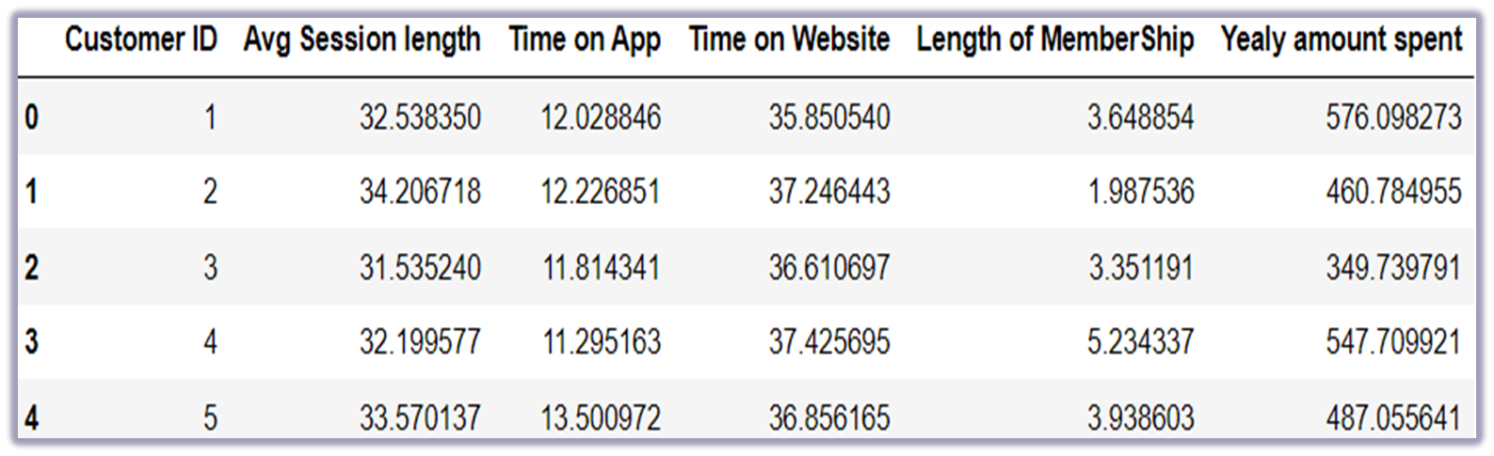
Sample Data

Slide 13
Statistical summaries
 | count | mean | std | min | 25% | 50% | 75% | max
Customer ID | 623.0 | 312.000000 | 179.988889 | 1.000000 | 156.500000 | 312.000000 | 467.500000 | 623.000000
Avg Session length | 623.0 | 33.039429 | 0.949071 | 29.972300 | 32.375680 | 33.044399 | 33.700947 | 35.744415
Time on App | 623.0 | 12.001459 | 0.996609 | 9.273248 | 11.334163 | 11.998823 | 12.647695 | 15.138317
Time on Website | 623.0 | 37.079018 | 0.991753 | 33.751071 | 36.376725 | 37.113631 | 37.773880 | 40.808388
Length of MemberShip | 623.0 | 3.514850 | 0.948063 | 0.891398 | 2.906558 | 3.504771 | 4.140305 | 6.553916
Yealy amount spent | 623.0 | 499.600023 | 80.032965 | 256.670000 | 447.665160 | 498.806136 | 551.257208 | 775.337626

Slide 14
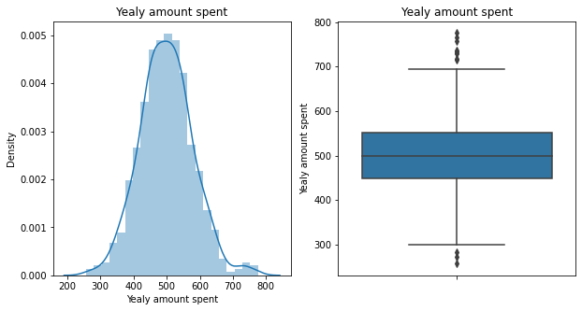
Exploratory Data Analysis
Boxplot
Distplot

Slide 15
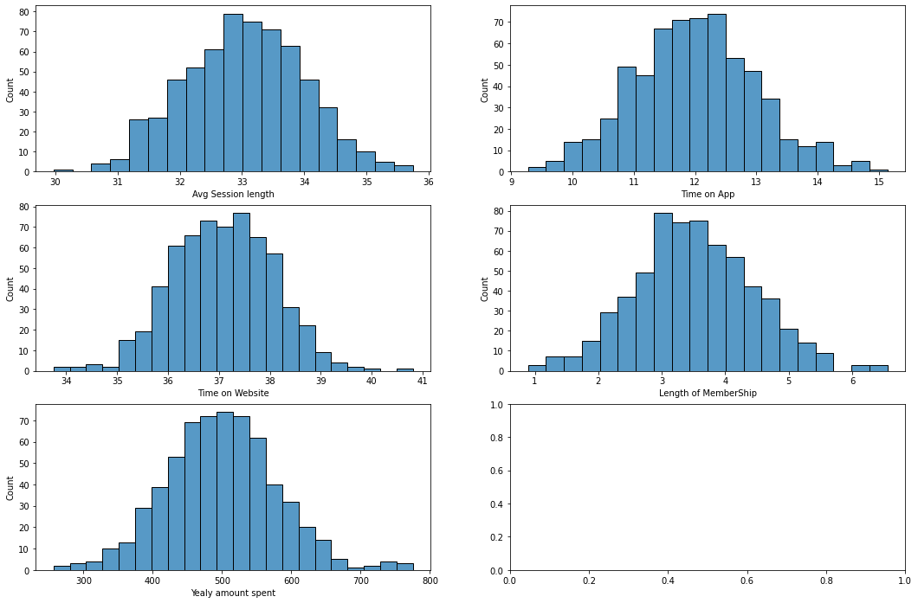
Histogram

Slide 16
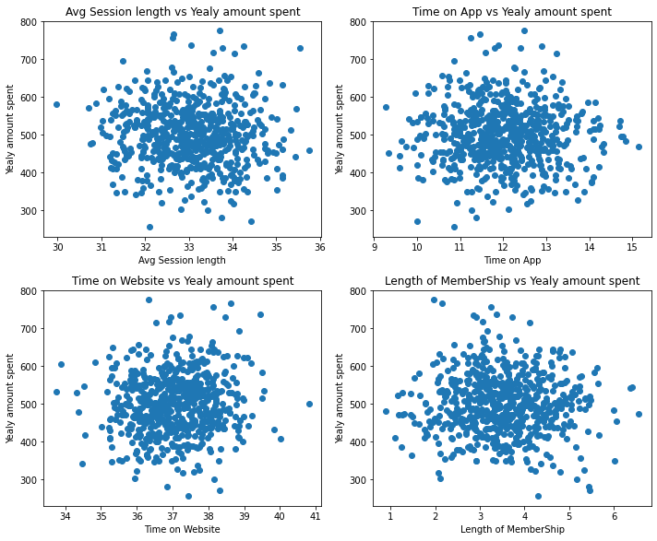
Scatterplot

Slide 17
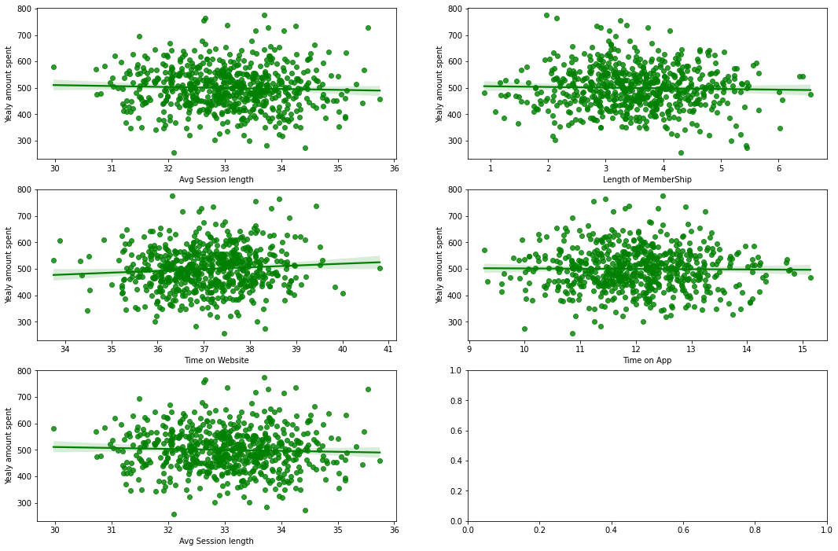
Regplot

Slide 18
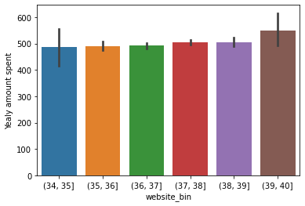
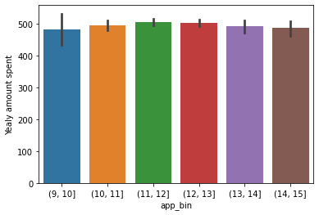
Barplot

Slide 19
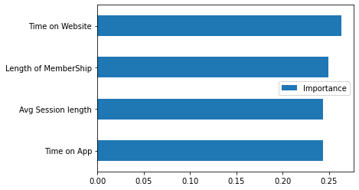
Feature importance

Slide 20
MAE & RMSE ERRORS
 | MAE_test | MAE_train | RMSE_test | RMSE_train
ElasticNetCV | 60.012287 | 62.918013 | 73.447169 | 80.585799
Lasso | 60.056694 | 62.884589 | 73.460515 | 80.592627
Ridge | 60.382623 | 62.892897 | 73.847466 | 80.565753
LinearRegression | 60.387280 | 62.892734 | 73.852772 | 80.565750

Slide 21
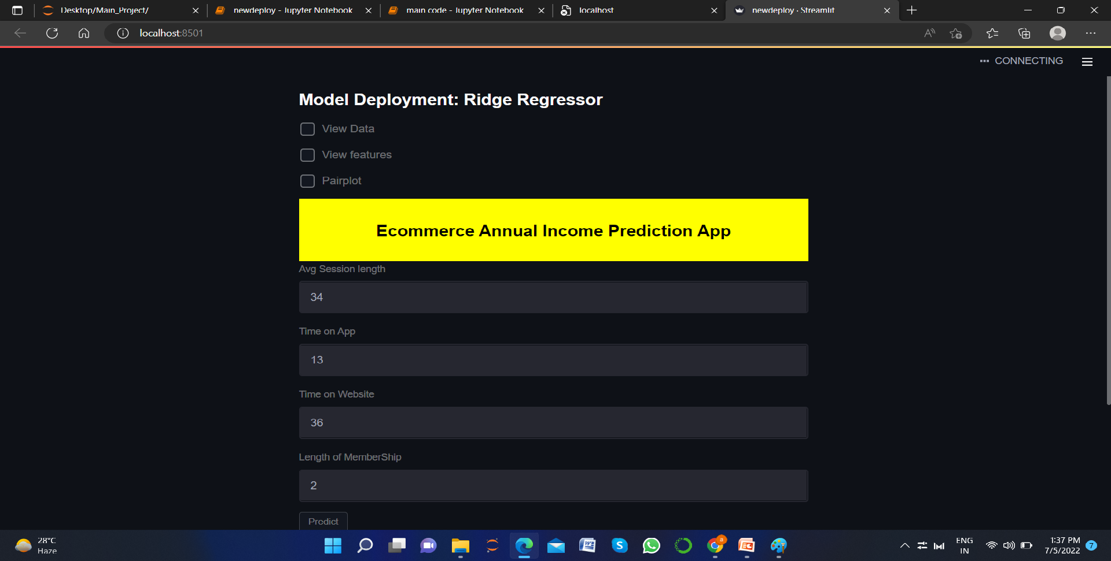
Deployment

Slide 22
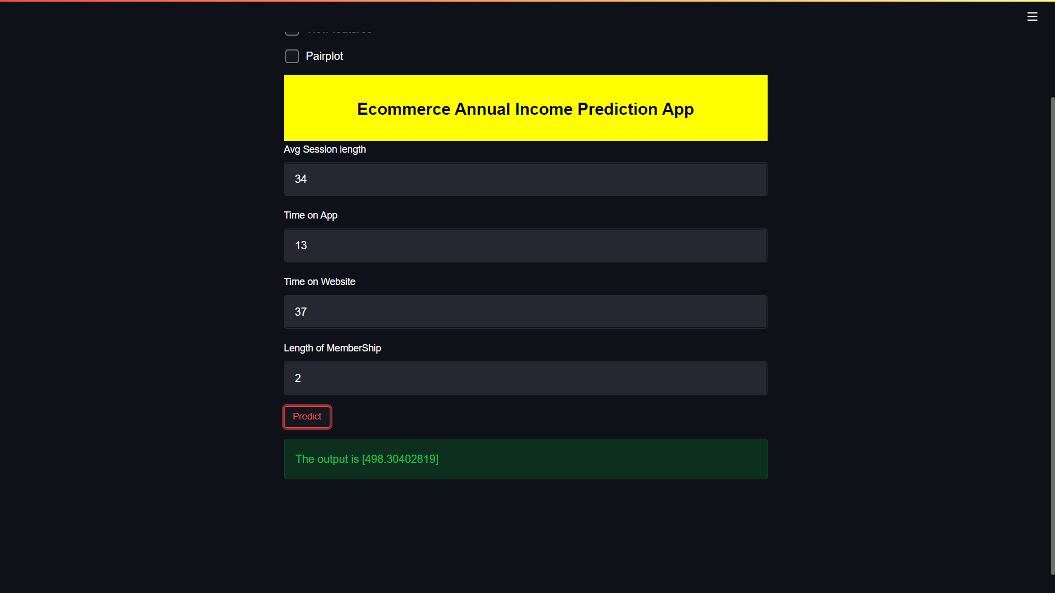

Slide 23
FUTURE ENHANCEMENT
Company can generate more revenue
Identify which variable is most influential
Identify and improve the declining of the business

Slide 24
DEVELOPING ENVIRONMENT
Hardware Requirements
•Processor - Intel Core i5 (min)
•Speed - 1.5 GHz (min)
•RAM - 8 GB (min)
•Hard Disk - 100 GB or (min)
•GPU - 1 GB (min)
Software Requirements
•Language :Python
•Front end : Python Jupyter
•Operating system : windows 8 or above
•IDE : Anaconda Navigator
•Dataset: 2020 sales result

Slide 25
PROJECT PLAN
User Story ID | Task Name | Start Date | End Date | Hours | Status
1 | Sprint 1 | 20/04/2022 | 2/05/2022 | 19 | Completed
2 |  | 4/05/2022 | 14/05/2022 |  | Completed
4 | Sprint 2 | 16/05/2022 | 20/05/2022 | 10 | Completed
5 |  | 22/05/2022 | 24/05/2022 |  | Completed
6 | Sprint 3 | 25/05/2022 | 5/06/2022 | 7 | Completed
8 | Sprint 4 | 6/06/2022 |  |  | In progress

Slide 26
USER STORY
User Story ID | As a type of User | I want to <perform some task> | So that I can < Achieve Some Goal>
1 | ADMIN | Predict the Annual Income of a new record | View the annual income of new record

Slide 27
PRODUCT BACKLOG
Sl.No | Priority <High / Medium / Low> | Size (Hours) | Sprint <#> | Status <Planned / In progress / Completed> | Release Date | Release Goal
1 | High | 6 | 1 | Completed |  | Data Understanding
2 | High | 6 |  | Completed |  | Data Preparation
3 | High | 4 |  | Completed |  | EDA on Distplot & Boxplot
4 | Medium | 6 | 2 | completed |  | Feature Exploration on Pairplot
5 | High | 2 |  | Completed |  | Feature Exploration on Regplot
6 | High | 2 |  | completed |  | Data Splitting
7 | High | 10 | 3 | Completed |  | Modeling
8 | Low | 2 | 4 | Incomplete |  | Web Page Design
9 | High | 6 |  | Incomplete |  | Final Prediction
10 | High | 1 |  | Incomplete |  | Raw file conversion

Slide 28
SPRINT PLAN
Backlog Item | Status And Completion Date | Original Estimation in Hours | Day 1 | Day 2 | Day 3 | Day 4 | Day 5 | Day 6 | Day 7 | Day 8 | Day 9 | Day 10 | Day 11 | Day 12 | Day 13 | Day 14
 |  |  | hrs | hrs | hrs | hrs | hrs | hrs | hrs | hrs | hrs | hrs | hrs | hrs | hrs | hrs
Data Understanding | 2/05/2022 | 6 | 1 | 1 | 1 | 1 | 0 | 1 | 0 | 0 | 1 | 0 | 0 | 0 | 0 | 0
Data Preparation | 8/05/2022 | 6 | 1 | 1 | 0 | 1 | 1 | 0 | 1 | 1 | 0 | 0 | 0 | 0 | 0 | 0
Exploratory Data Analysis | 14/05/2022 | 4 | 1 | 0 | 0 | 1 | 1 | 0 | 0 | 0 | 0 | 0 | 0 | 0 | 0 | 0
Feature Exploration | 20/05/2022 | 8 | 0 | 2 | 1 | 0 | 2 | 0 | 3 | 0 | 0 | 0 | 0 | 0 | 0 | 0
Data Splitting | 24/05/2022 | 2 | 1 | 1 | 0 | 0 | 0 | 0 | 0 | 0 | 0 | 0 | 0 | 0 | 0 | 0
Modelling | 01/06/2022 | 6 | 3 | 3 | 0 | 0 | 0 | 0 | 0 | 0 | 0 | 0 | 0 | 0 | 0 | 0
Full Training | 04/06/2022 | 1 | 1 | 0 | 0 | 0 | 0 | 0 | 0 | 0 | 0 | 0 | 0 | 0 | 0 | 0
Deployment(Prediction) | 25/06/2022 | 5 | 3 | 2 | 0 | 0 | 0 | 0 | 0 | 0 | 0 | 0 | 0 | 0 | 0 | 0
Total |  | 41 | 11 | 8 | 2 | 3 | 4 | 1 | 4 | 1 | 1 | 0 | 0 | 0 | 0 | 0

Slide 29
SPRINT ACTUAL
Backlog Item | Status And Completion Date | Original Estimation in Hours | Day 1 | Day 2 | Day 3 | Day 4 | Day 5 | Day 6
 |  |  | hrs | hrs | hrs | hrs | hrs | hrs
Data Understanding | 2/05/2022 | 6 | 0 | 1 | 1 | 1 | 0 | 3
Data Preparation | 8/05/2022 | 7 | 1 | 0 | 0 | 0 | 3 | 3
Exploratory Data Analysis | 14/05/2022 | 5 | 1 | 0 | 1 | 1 | 1 | 0
Feature Exploration | 20/05/2022 | 10 | 1 | 1 | 1 | 1 | 2 | 4
Data Splitting | 24/05/2022 | 3 | 1 | 1 | 0 | 1 | 0 | 0
Modelling | 01/06/2022 | 9 | 3 | 3 | 3 | 0 | 0 | 0
Full Training | 04/06/2022 | 1 | 1 | 0 | 0 | 0 | 0 | 0
Deployment(Prediction) | 30/07/2022 | 6 | 2 | 2 | 2 | 0 | 0 | 0
Total |  | 47 | 8 | 6 | 6 | 4 | 6 | 10

Slide 30
THANK YOU

